Slide 1
Design at the Register Transfer Level
Chapter 8 supplement

Slide 2
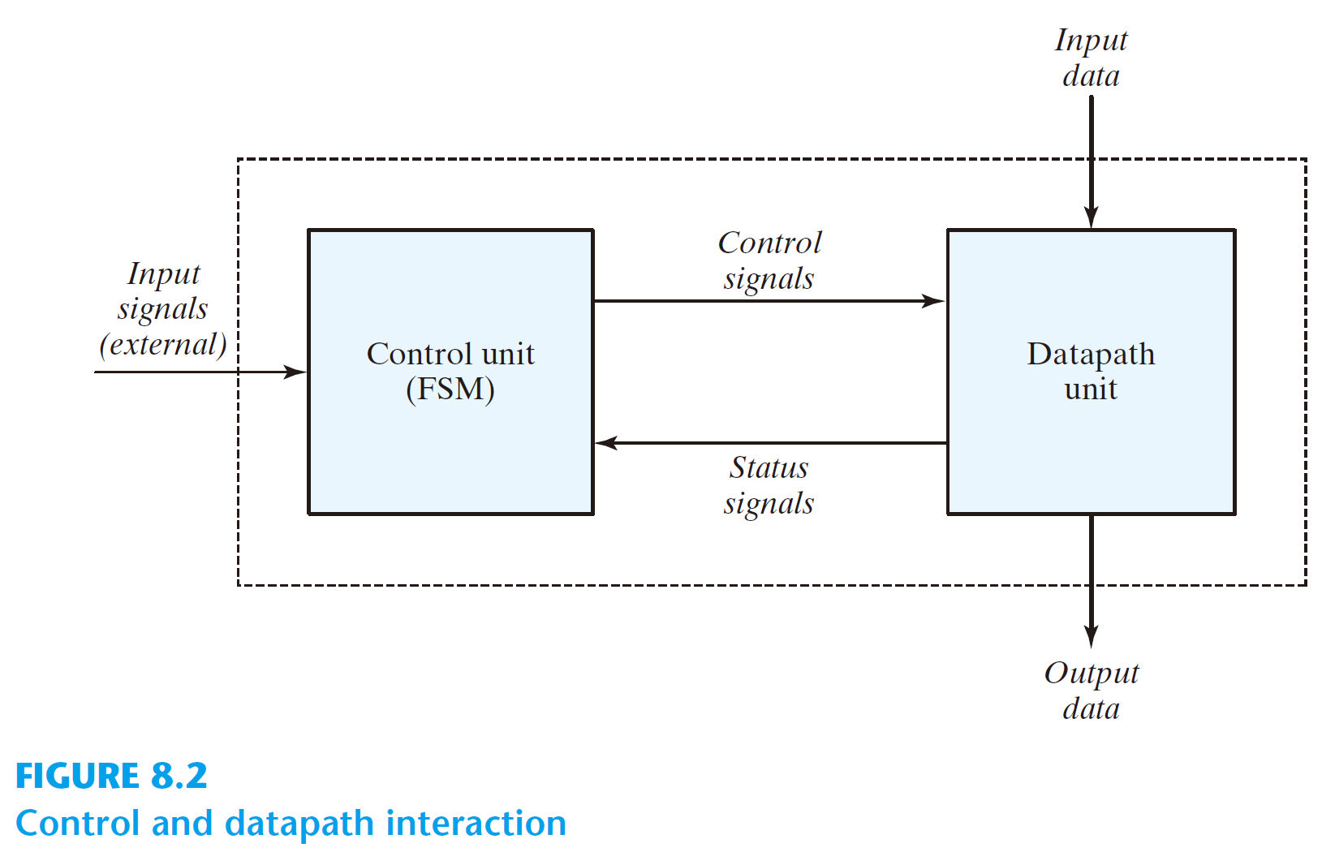

Slide 3
GCD in Python
def GCD(inA, inB):
A = inA
B = inB
done = 0
while not done:
if A < B:
A, B = B, A
elif B:
A = A - B
else:
done = 1
return(A)

Slide 4
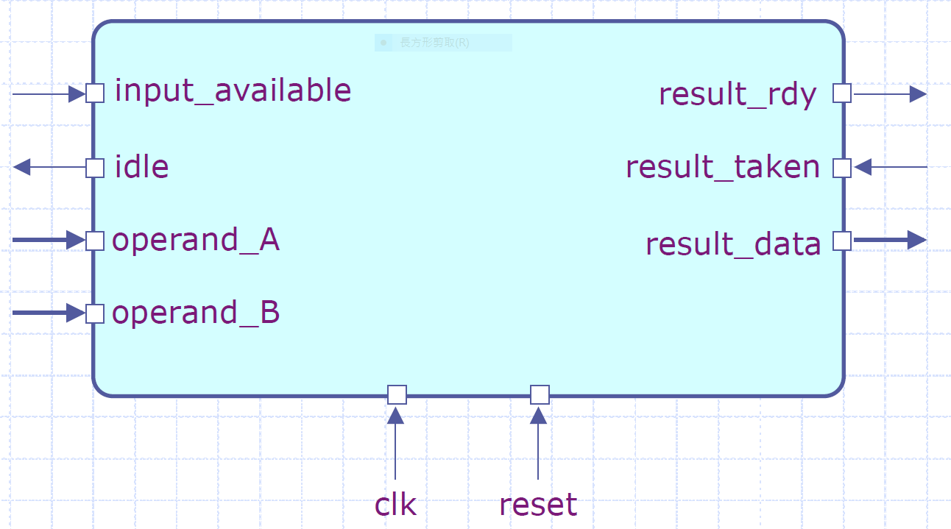
Design an appropriate port interface
Courtesy of Arvind http://csg.csail.mit.edu/
  either busy or waiting for input or
  waiting for output to be picked up

Slide 5

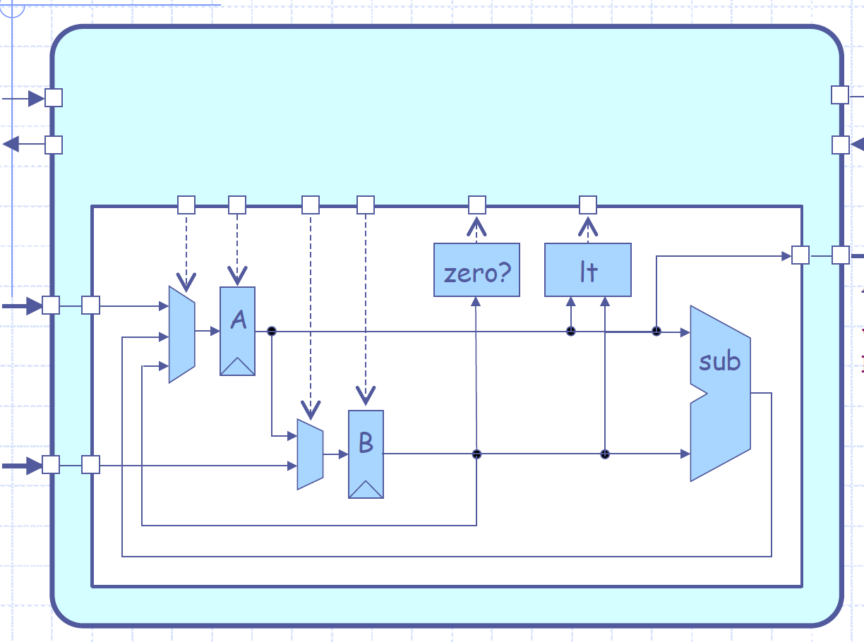
Design a datapath

Slide 6
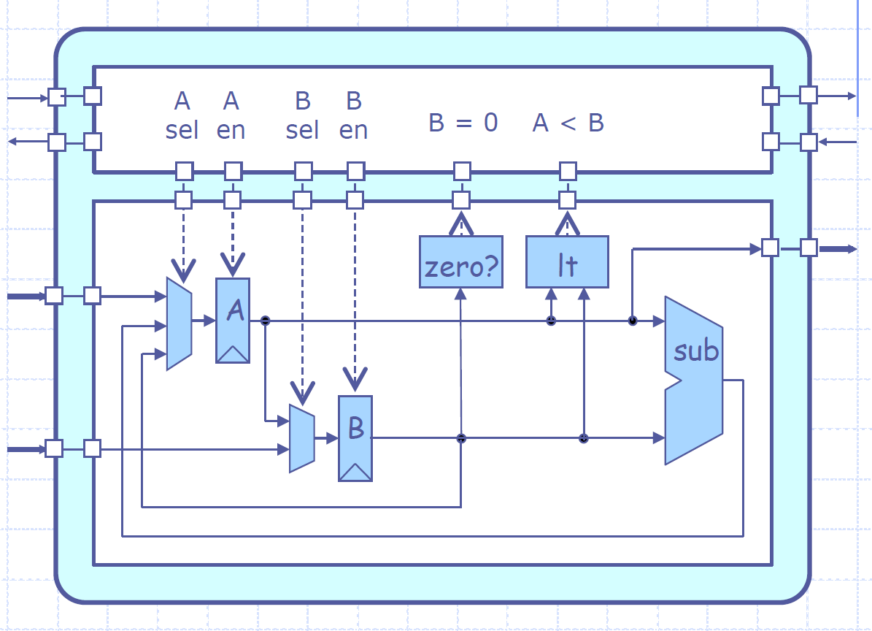
Add a control unit
either busy or waiting for input or
waiting for output to be picked up

Slide 7
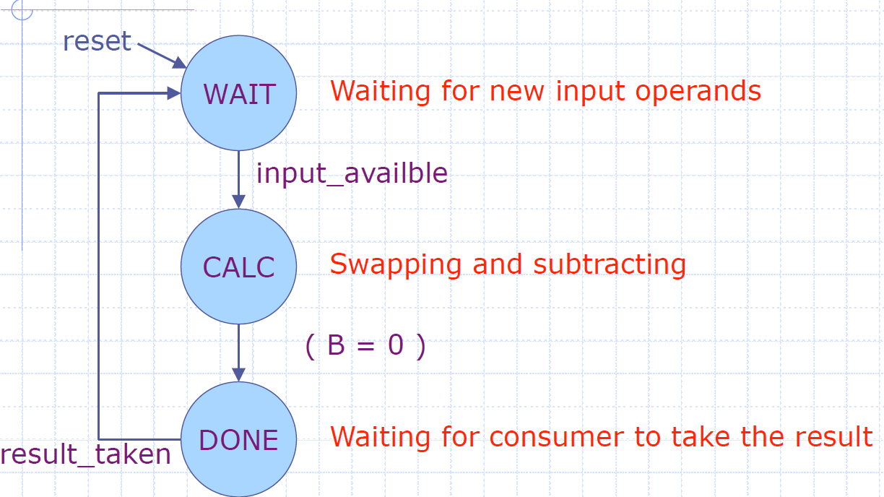
Control unit
A FSM

Slide 8
Detailed FSM

Slide 9
module GCD_cntrl (idle, result_rdy, A_en, B_en, B_sel, clk, reset_, input_available, result_taken, B_zero, A_lt_B, A_sel);
output reg idle, result_rdy, A_en, B_en, B_sel;
input clk, reset_, input_available, result_taken, B_zero, A_lt_B;
output reg [1:0] A_sel ;

Slide 10
parameter WAIT = 2'd0, CALC = 2'd1, DONE = 2'd2;
parameter A_sel_In= 2'b00, A_sel_B=2'b01, A_sel_Sub=2'b10, A_sel_X=2'bxx;
parameter B_sel_In= 1'b0, B_sel_A= 1'b1, B_sel_X=1'bx;
parameter W = 16;

Slide 11
reg [1:0] next_state;
reg [1:0] state;
always @(*)
begin
next_state = state ;
case ( state )
WAIT : if ( input_available )
next_state = CALC;
CALC : if ( B_zero )
next_state = DONE;
DONE : if ( result_taken )
next_state = WAIT;
default: next_state = 2'bxx;
endcase
end

Slide 12
always @(posedge clk or negedge reset_)
if(!reset_)
state = WAIT ;
else
state = next_state ;

Slide 13
always @(*)
//Default control signals
begin
A_sel = A_sel_X;
A_en = 1'b0;
B_sel = B_sel_X;
B_en = 1'b0;
idle = 1'b0;
result_rdy = 1'b0;

Slide 14
case ( state )
WAIT: begin
A_sel = A_sel_In;
A_en = 1'b1;
B_sel = B_sel_In;
B_en = 1'b1;
idle = 1'b1;
end

Slide 15
CALC: if ( A_lt_B ) begin
A_sel = A_sel_B;
A_en = 1'b1;
B_sel = B_sel_A;
B_en = 1'b1;
// idle = 1'b0;
end
else if ( !B_zero ) begin
A_sel = A_sel_Sub;
A_en = 1'b1;
// idle = 1'b0;
end
DONE: begin
result_rdy = 1'b1;
end
endcase
endendmodule

Slide 16
module GCDdatapath (clk, operand_A, operand_B, result_data, A_en, B_en, A_sel, B_sel, B_zero, A_lt_B);
input clk;
input [W-1:0] operand_A, operand_B;
output [W-1:0] result_data;
input A_en, B_en;input [1:0] A_sel;input B_sel
output B_zero, A_lt_B;
reg [W-1:0] A_out;
reg [W-1:0] A;
reg [W-1:0] B_out;
reg [W-1:0] B;
wire [W-1:0] sub_out;

Slide 17
always @(*)
case (A_sel)
A_sel_In: A_out = operand_A ;
A_sel_B: A_out = B ;
A_sel_Sub: A_out = sub_out;
default: A_out = 16'bx ;
endcase
always @(posedge clk)
if (A_en)
A = A_out;

Slide 18
always @(*)
case(B_sel)
B_sel_In: B_out = operand_B ;
B_sel_A: B_out = A ;
default: B_out = 16'bx ;
Endcase
always @(posedge clk)
if (B_en)
B = B_out ;

Slide 19
assign B_zero = (B==0);
assign A_lt_B = (A < B);
assign sub_out = A - B;
assign result_data = A;
endmodule

Slide 20
in_mdl and out_mdl

Slide 21
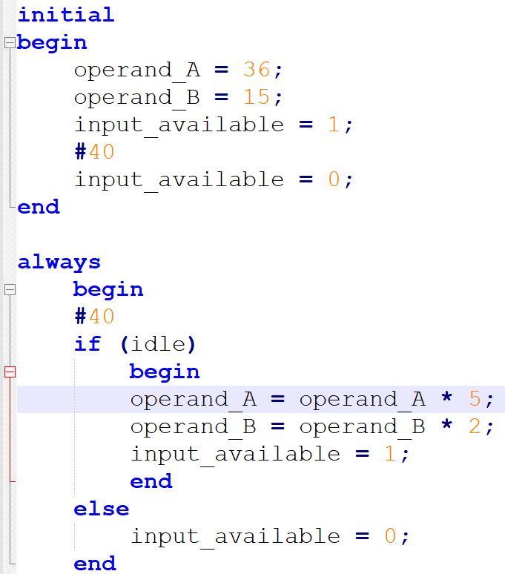
in_mdl

Slide 22
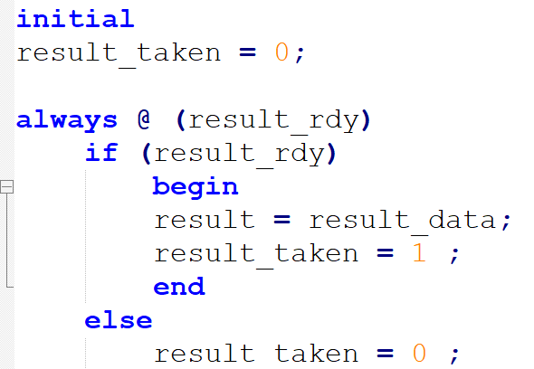
out_mdl

Slide 23
Verilog MP 4
Download GCD1.v from e3
  iverilog -o GCD1.vvp GCD1.v
  vvp GCD1.vvp
  gtkwave GCD1.vcd

Slide 24
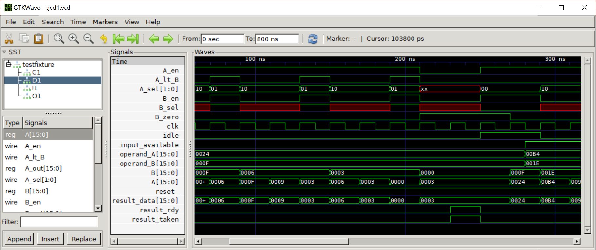

Slide 25
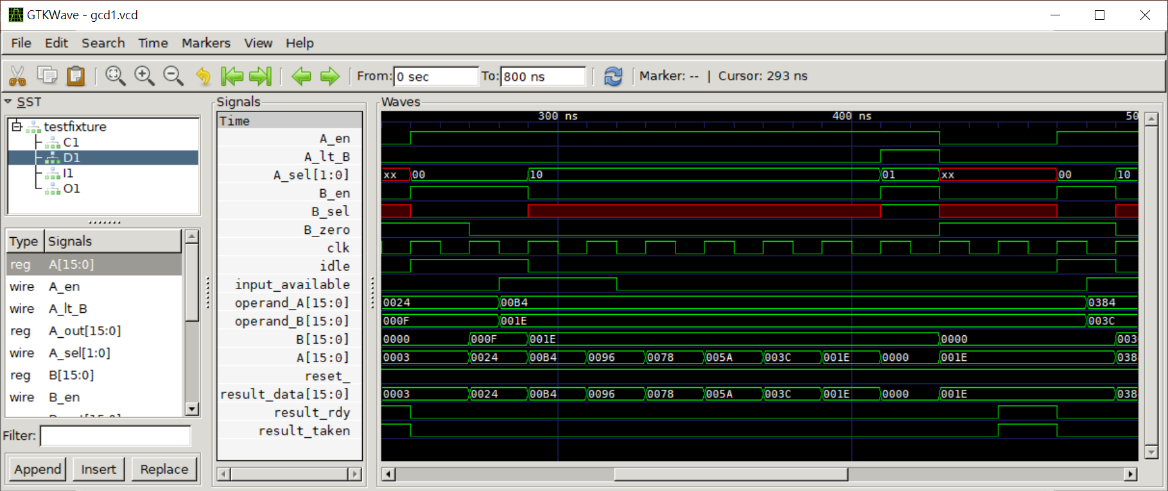

Slide 26
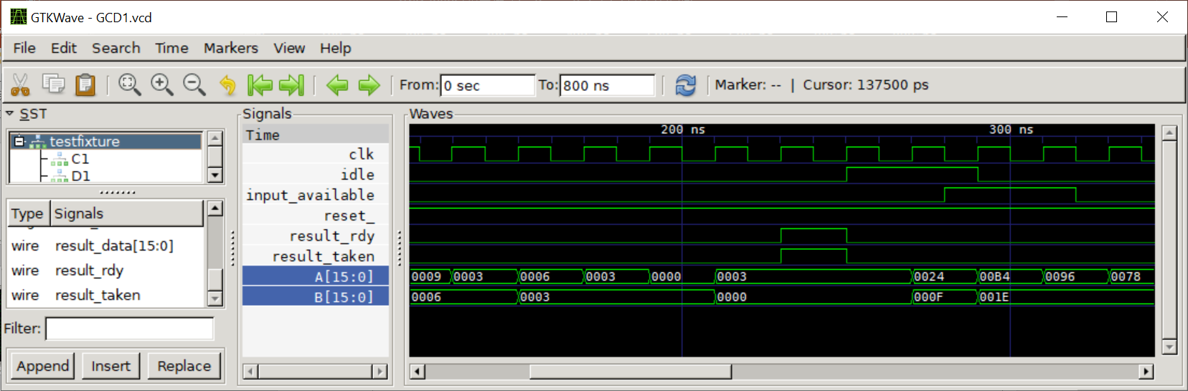

Slide 27
Verilog MP 4
def GCD(inA, inB):
A = inA
B = inB
done = 0
while not done:
if A < B:
A, B = B-A, A
elif B:
A = A - B
else:
done = 1
return(A)

Slide 28
Verilog MP 4
Modify the control unit and datapath
Modify GCD1.v for your new design

Slide 29
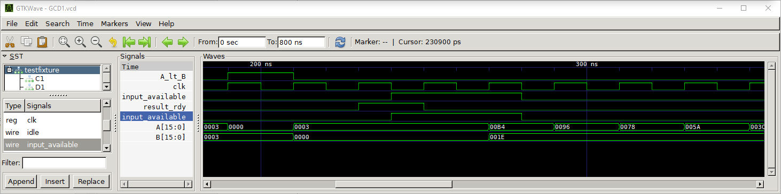
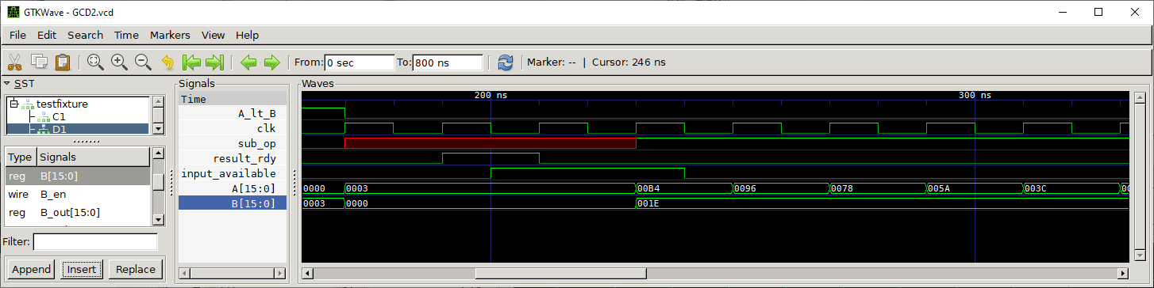
Results

